Slide 1

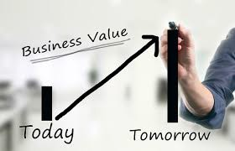
MIS782
Value of Information
Module 4: Week 7

Slide 2
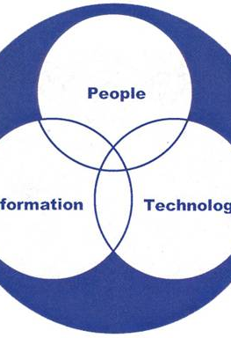
Assignment 2 Presentations
Any Questions? Please use the discussion forum for Assignment 2

Slide 3
ASS 2: Video presentation, due week 8 Seminar
Provide a summary of your business case for an data-driven/new experience investment.
This should be treated as a “pitching” exercise. The aim is to sell/persuade your business case proposal to the management.
The presentation should be less than 5 minutes long and must include all team members to pitch the key points of the report.
The presentation thus may have short summaries of the first five steps we recommended to write a business case (no need to elaborate on analysis of the alternatives, but some justification for selected choice for implementation should be given).
Video link uploaded in CloudDeakin Assignment Task 2 Dropbox

Slide 4
MIS782: Value of information
HOW DO ICT INVESTMENTS GENERATE VALUE?
Firms need to understand: | How to gain competitive advantage based on the their underlying resources. | How competitive advantage from business and how emerging IT opportunities, such as social media analytics, can generate business value from investments in these areas. | Analyse how organisations adapt to changes or disruptors in the technology landscape to preserve and sustain an advantage.
In this unit, we will discuss: | Course One + Two | Course Three + Four | Course Five
 | Business Value Returns from IT Investments IT Portfolio Theory 3. Analysing competitive advantage - RBV 4. Analysing competitive advantage - VRIO | Analytics as a capability - I Business Case Development Analytics as a capability - II: From business data to business insight Emerging sources and SMA | 9. Dynamic capabilities through Information Asymmetries 10. Competing on Information Asymmetries

Slide 5
What is analytics and what are analytical capabilities?
Analytics capabilities
What are they?
Ways of structuring analytics capabilities
Organising analytics capabilities within a business
Information Value and the spectrum of decisions enabled by analytics capabilities:
Range
Sophistication

Slide 6
Building Analytical Capability
 Constraints of information capture (information architecture)
 3 Antecedent Conditions (3R’s)
 Build information repository to extract value
 4 Value Dimensions
 Build in Flexibility
 1 or more Virtuous Feedback Cycles (Dynamic
Capabilities)

Slide 7

Building Analytical Capability
 How do organisations build up analytics capabilities to develop the value of their information resource?
(hint: think back to the RBV)
 Moneyball trailer: analytics in sports
 How do the 4 dimensions of information value
benefit the baseball team in Moneyball?

Slide 8

From Raw Data to Business Decisions
 Primary objective of organisations’ analytical capabilities are to help the business make optimal decisions
 Consider the RBV: Which types of resources yield an organisational capability to deploy analytical capabilities?
Is having access to information enough? Do you need to own it as an
internal resource?

Slide 9

Gaining Information Asymmetries
´ An informational competitive advantage exists when a firm has access to competitively valuable information which is not readily available to its competitors, and which can be deployed competitively.
´ VRIO:
´ Four information value dimensions
´ Analytics capability

Slide 10
Information Asymmetry
A’s Value of Information
Organisation A
B’s Value of Information
Organisation B

Slide 11
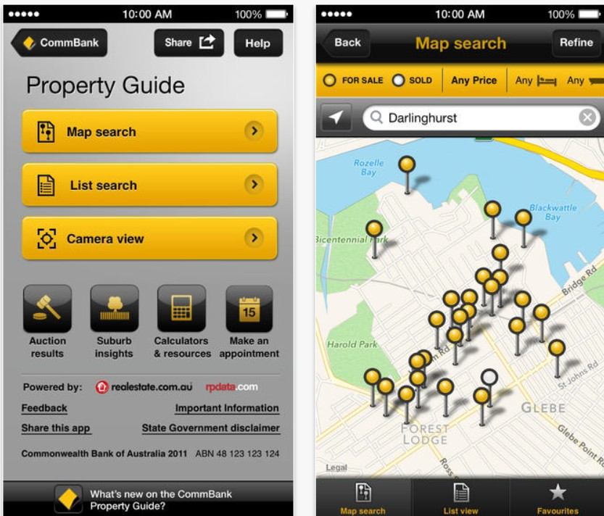
Developing Information Asymmetries
´ VRIO
´ Having V, R or I information
´ Having the O to use the information
´ Making smarter decisions than competitors
´ It is not necessary to own the information
´ Alliances possible
´ Commonwealth Bank has partnered with Realestate.com.au to develop a location-aware application (see right)
´ App enables prospective homebuyers to access information from realestate.com.au about the property, and to obtain financial details and financing options on the spot
Notes:
Commonwealth Bank has partnered with a Realestate.com.au and have developed a location-aware mobile phone application to enable prospective homebuyers, standing outside a property of interest, to obtain details about the property, typical prices in the area, etc., and then to apply for preapproval for finance on the spot.
This is an example of how the concept of a information resource can be extended to the inter-firm context (refer Das and Teng 2000; Eisenhardt and Schoonhoven 2000), notably in terms of having access to, rather than direct control of, resources.

Slide 12
Information Value through Alliances with Partner Organisations
Note that having access to, rather than owning/controlling an information resource is adequate to extract value. So information value development might include carefully chosen alliances.
Why is this important?
Collaboration with partner organisations often mean that such partners have information, which in combination can enhance Value on Breadth, Depth, Scope or Time.
Consider the following example from industry, and how that might be applicable to your organisation:

Slide 13

How can Deakin create an information asymmetry to gain a competitive advantage over other Victorian universities?

Slide 14
Typical steps in the analytics process
Data cleansing
Describe:
Visualise key indicators
Predict:
Natural Language processing (e.g. extract nouns, verbs, adjectives)
Aggregate indicators to create variables
Decide on independent and dependent/outcome variables (e.g. sentiment)
Build a data model
Use training data and testing data to verify predictive capability of model
Prescribe:
Model scenarios fro different interventions
Identify specific set of interventions to improve outcomes

Slide 15

Modes of Decision Making
How would you organise analytics capabilities within a business?
´ Pull mode
´ Your manager asks you for certain information
´ Push mode
´ Uncovering insights which stakeholders couldn’t envision asking beforehand
What are the relative strengths of push versus pull modes?
How does the strategic management process relate to this?
Notes:
Stakeholder value creation typically involves a 2-way discussion:
stakeholders may express particular needs in terms of analyses (pull mode), or
providers of analyses often suggest novel analyses to address emerging needs (push mode).
Clearly, significant benefit may arise through the combination of both of these modes

Slide 16
´ How do you organise to facilitate decision making?
´ One centrally located analytics unit?
´ Analytics people in every unit?
Centralised
Decentralised
Sales
Marketing
Analytics capability
Finance
Sales
Finance
Analytics team
Marketing
Analytics capability
Analytics capability
Customer satisfaction
Customer satisfaction
Analytics capability
How would you organise a large business’s analytics capabilities? What are the pros and cons of each configuration?

Slide 17
Do you know how Deakin has organised its analytics capability?
What information would you want to ‘pull’?
What type of information would you expect to ‘push’?

Slide 18
Bringing It All Together – Alignment of asymmetric information
Analytical Capabilities
Knowledge & Skills
´ ´ Making sure you can perform analytics
´ From raw data to decisions
´ Variety of decisions you can make and impact that decisions will have
Big Data
Potential
Stakeholder
Value Creation
Technical Systems & Processes
Internal Capabilities, e.g.:
Data Sourcing
Transformation
Combination
Value Dimensions
Volume
Scope
Granularity
Time
Decision Spectrum
Range
Depth
Stakeholders
Stakeholders
Stakeholders
Managerial Systems & Processes
Values & Norms
The Principal framework (presented by Scheepers, R. at the IBM Centre for Excellence in 2016).

Slide 19
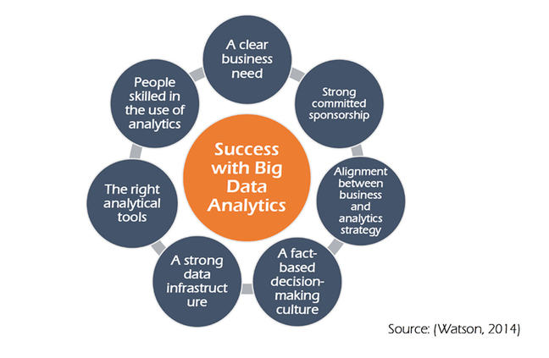
A framework for being successful with big data analytics

Slide 20
Next Class..
 Emerging sources and Social Media Analytics
 We will look into SMA and how we can use SMA for insights into customer behaviour and engagement.
Now time for Guest Presentation by Dr Sankalp Khanna
Sankalp Khanna is a Principal Research Scientist and leads the Health Intelligence team at the CSIRO Australian e-Health Research Centre. His research is focussed on informing and improving the performance and sustainability of the Australian health system, and developing clinical and operational decision support tools to support and improve patient care. Sankalp is also Adjunct Associate Professor at the Queensland University of Technology, Senior Adjunct Research Fellow at Griffith University, the Secretary of the Pacific Rim International Conference on Artificial Intelligence (PRICAI) Steering Committee, and a founding Fellow of the Australasian Institute of Digital Health.

